Slide 1
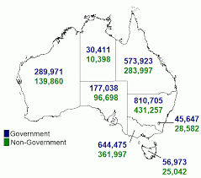
Project Title: Schools Australia
Team members
Jasjeet Kaur
Hesh Kuruppuge
Yao Ding
Aravind Sama
DATA SOURCE: ABS Schools Australia
A map of Australia showing student enrolment counts by state and territory and affiliation for 2020

Slide 2
Research Purpose
To look at student enrolment trends in public and private education system in Australia at a National and
state or territory level
Research Questions
What is the number and percentage of student enrolment by state in last 5 years (2016-2020) by state?
How does indigenous and non indigenous enrolment differs in each state/territory in last 5 years (2016-2020)
Is there a difference in student enrolments pre (2018) and post (2020) pandemic period?
What is the number and percentage of student enrolment by affiliation in last 5 years (2016-2020) nationally and by state/territory?
5) What is the trend in student enrolments for last 15 years for each Australian state/territory?

Slide 3
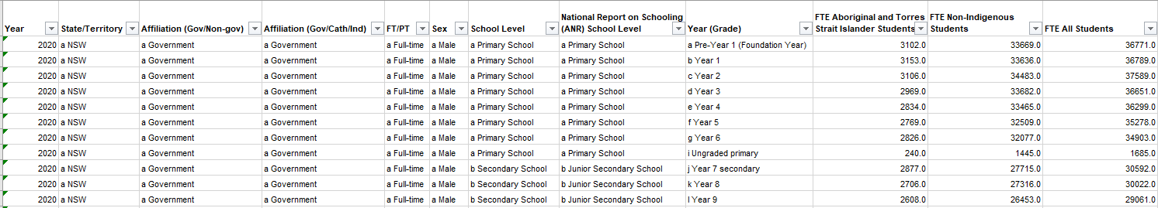
Data Source
ABS Schools Australia
Australian Bureau of Statistics
Schools, 2020
Data on students, staff, schools, rates and ratios for government and non-government schools, for all Australian states and territories (60 kB)
Link to the data set
https://www.abs.gov.au/statistics/people/education/schools/latest-release
Table 43a was used
Table: 43a –14,000 R X 12 C

Slide 4

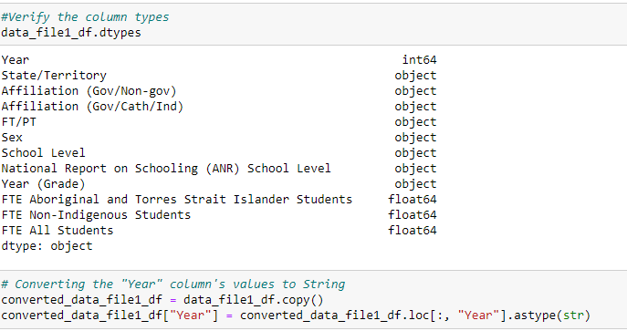
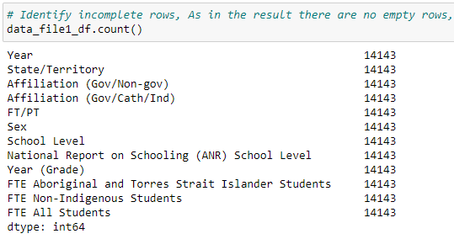
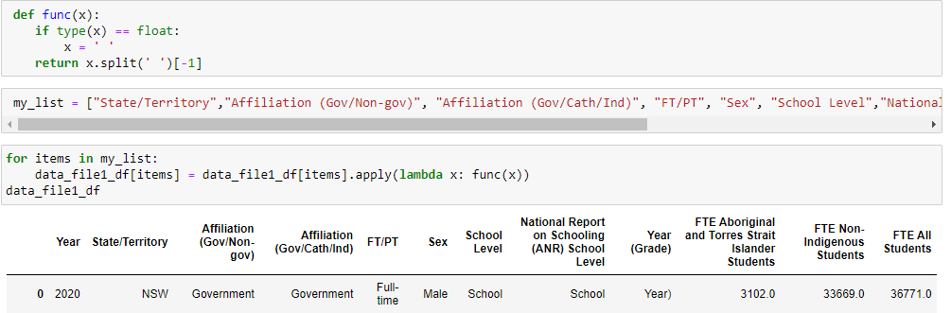
Data exploration and clean up
Jupyter notebook link
Read raw data was in excel
3. Checked the data types and converted year from integer to string
2. Screened for any empty rows
4. Removed prefixes in each column

Slide 5
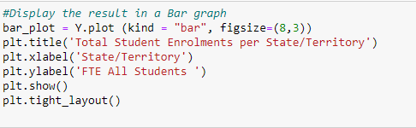
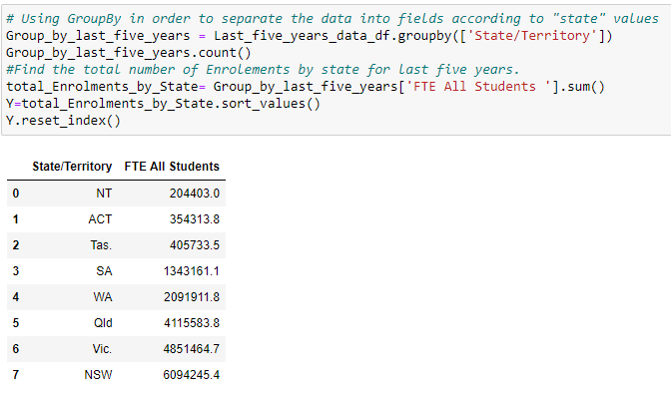
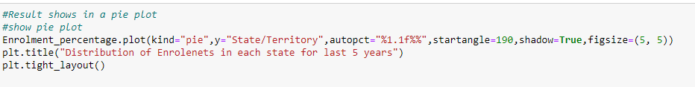

Data analysis process
Jupyter notebook link
Filtered data based on year column to get last five years data (2016-2020)
3. Created a Bar Graph from grouped data
2. Grouped variables and sorted values
4. Created a Pie Chart to calculate the percentage of student enrolment in grouped data
5. Created a scatter plot to look at the trend of student enrolment in each state

Slide 6
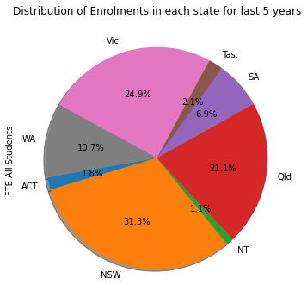
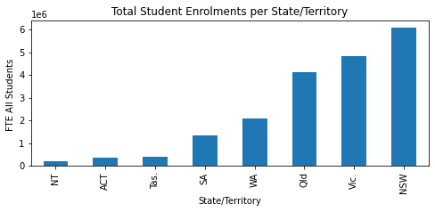
01) What is the number and percentage of student enrolment by state in last 5 years (2016-2020)?
NSW and Victoria have the highest number of student enrolments in last five years
NT and ACT have the lowest number of student enrolments in last five years
Creating a write-up summarizing your major findings. This should include a heading for each “question” you asked of your data and a short description of your findings and any relevant plots.

Slide 7
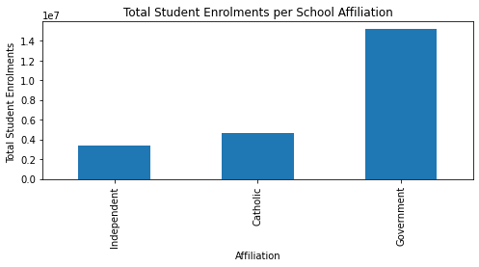
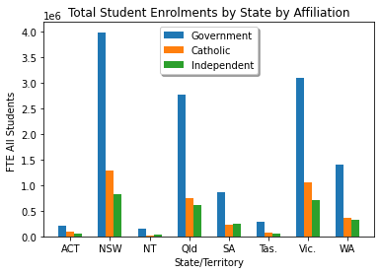
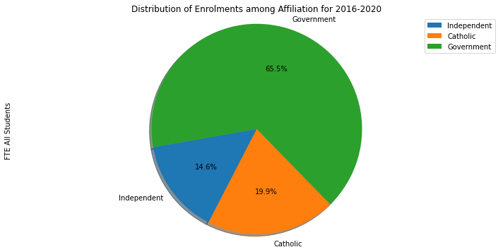
02) What is the number and percentage of student enrolment by affiliation in last 5 years (2016-2020) nationally and by state/territory?
By state/territory, government schools have higher student enrolments than non-government schools (catholic and independent)
Nationally, government schools have higher student enrolments than non-government schools (catholic and independent)
Creating a write-up summarizing your major findings. This should include a heading for each “question” you asked of your data and a short description of your findings and any relevant plots.

Slide 8
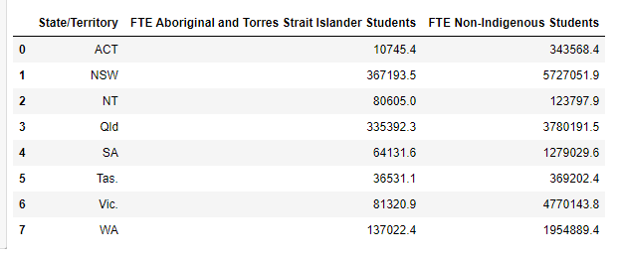
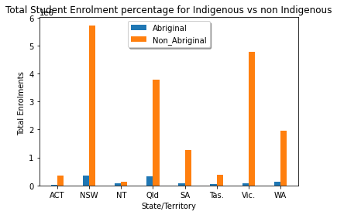
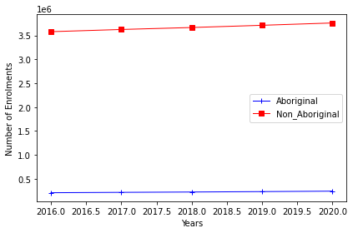
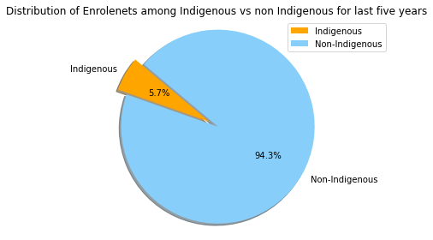
03) percentage of Indigenous vs non Indigenous enrolment by states - Pie chart

Slide 9
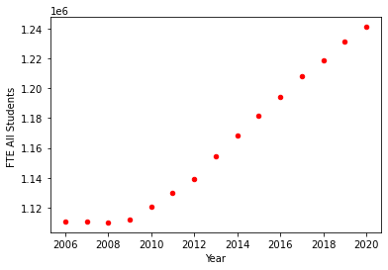
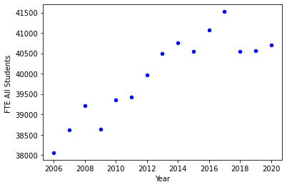
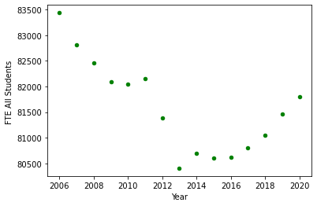
03) What is the trend in student enrolments for last 15 years for states recorded highest and lowest enrolments?
Is there a difference in student enrolments pre (2018) and post (2020) pandemic period in NSW, NT and Tas?
NSW
NT
Tas
In NSW, VIC, Qld, ACT, SA student enrolments follow an exponential trend since 2009
In NT, there is an increase in student enrolments until 2017 and then a decrease
In Tas, a recent increase in student enrolments is seen since 2016 after a drop since 2006
Creating a write-up summarizing your major findings. This should include a heading for each “question” you asked of your data and a short description of your findings and any relevant plots.

Slide 10
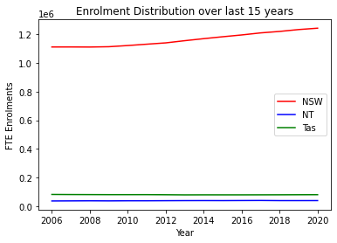
Student enrolments have continued to increase despite of the pandemic

Slide 11
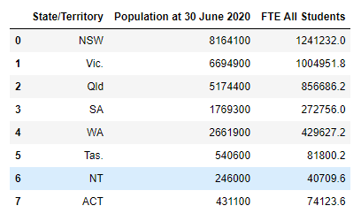
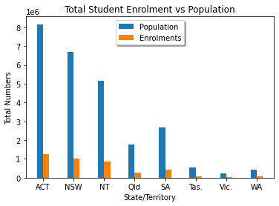
Enrolment vs population

Slide 12
Conclusions
Linear regression and Forecasting

Slide 13
The implications of your findings: What do your findings mean?
- How enrolments relates to the population, income?
-

